Slide 1
STAT 717: Lecture 5
Principal Component Analysis
Vitaly Druker
September 30th, 2021

Slide 2
Introduction
Principal components are concerned only with the core structure of a single sample of observations of p variables.
The first principal component is the linear combination with maximal variance
Second principal component is maximal variance that is orthogonal to first

Slide 3
Uses
Used to assess the contribution of each variable to the variance of the sample
Used as a dimension reduction technique
Used to ‘decorrelate’ variables

Slide 4
Geometric Approach
Imagine p variables, y1, y2 … yp
If they are correlated with each other then they take up an ellipsoidal space (similar to an ellipse in 2 dimensions)
In 2 dimensions – we want to find the axes of the ellipse and make them our ‘main’ axes.

Slide 5


Geometric Approach
This can be done by first translating the origin to ybar and then rotating the points. This can be done by multiplying by an orthogonal matrix (A).

Slide 6
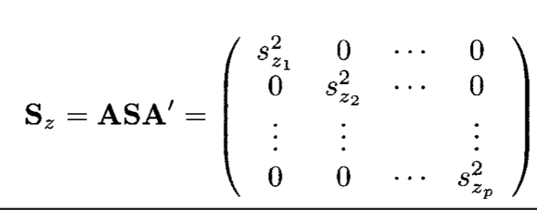
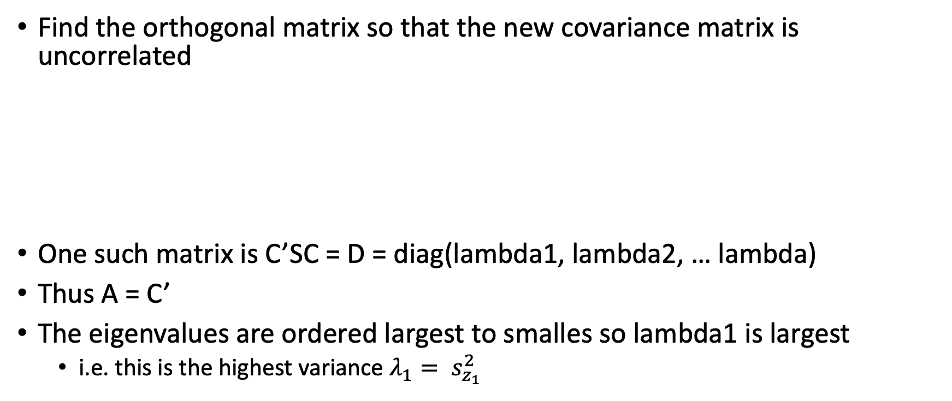
Geometric Approach
Find the orthogonal matrix so that the new covariance matrix is uncorrelated
One such matrix is C’SC = D = diag(lambda1, lambda2, … lambda)
Thus A = C’
The eigenvalues are ordered largest to smalles so lambda1 is largest
i.e. this is the highest variance $λ_{1}= s_{z_{1}}^{2}$

Slide 7
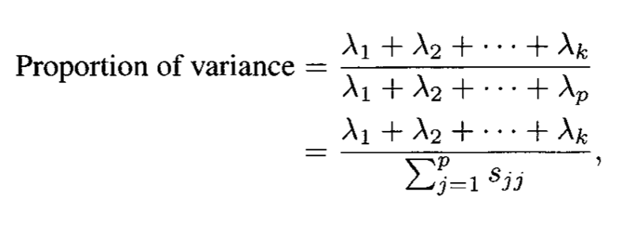
Proportion of variance explained
The proportion explained by the first k components:
If the variables are highly correlated, the essential dimensionality is much smaller than p

Slide 8
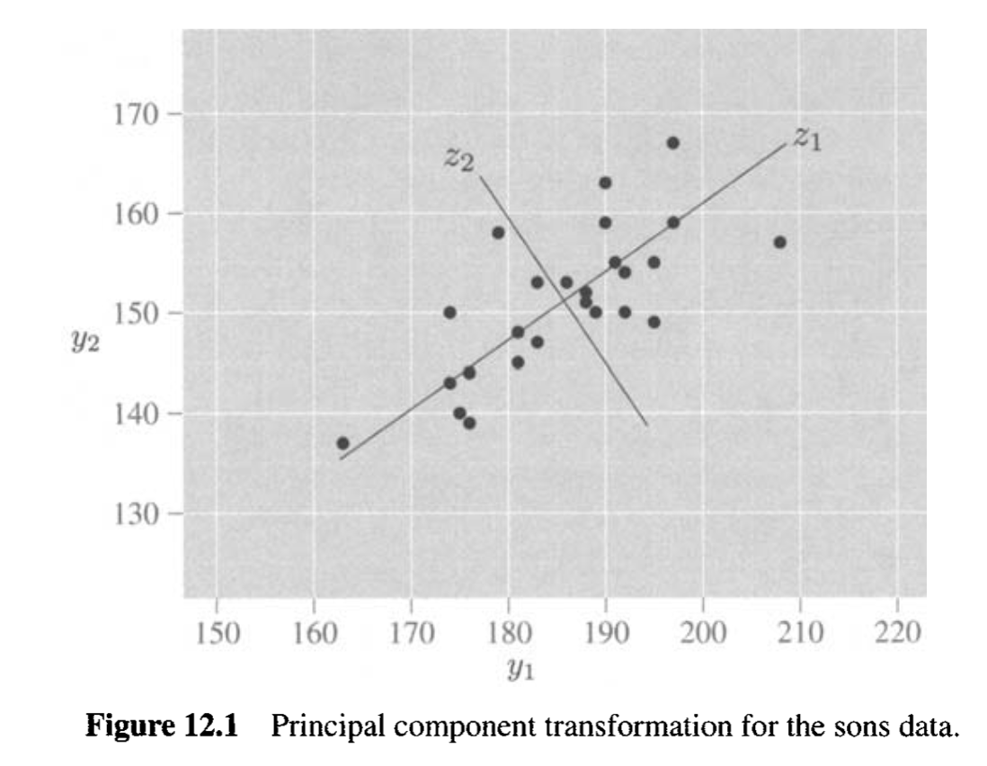
Example 12.2.1

Slide 9
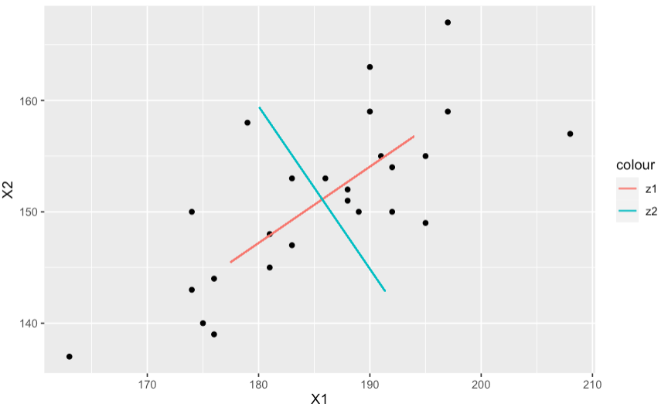
Recreated in R

Slide 10
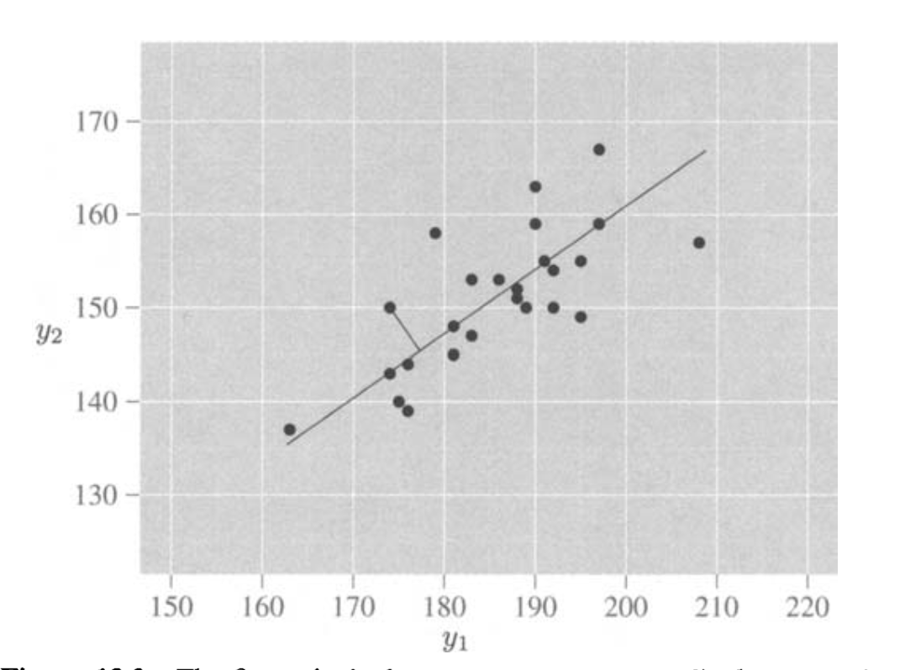
Other properties
The first principal component is a perpendicular regression line minimizing the distance in orange.
How is this different from normal regression?

Slide 11
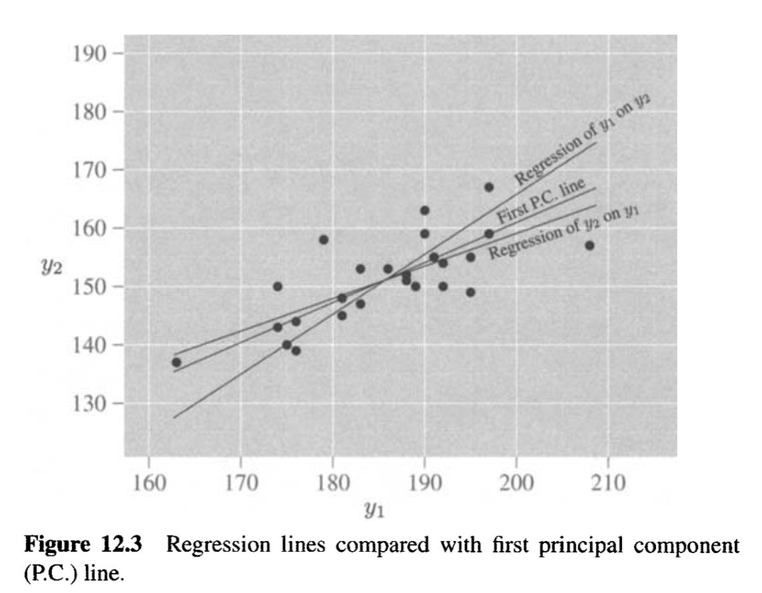
Regression vs PC

Slide 12
Principal Components from Correlations
In general covariance matrices are used.
However, if measurement units are not consistent/variances are different then the correlation matrix can be a good idea
The principal components from R are scale invariant – Why?
Same as making each unit have unit variance

Slide 13
Deciding how many components to retain

Slide 14
Various Strategies
No clear cut way – especially if there is no outcome to test against
Concerns:
Overfit the data (e.g. choose too many components) that are sample or variable specific
Underfit the data – don’t capture all the important variability

Slide 15
Various Strategies
Possible ways:
Retain sufficient components to account for a specified percentage of the total variance, say 80%
Retain the components whose eigenvalues are greater than the average of the eigenvalues
Use the scree graph, a plot of λ versus i, and look for a natural break between the "large" eigenvalues and the "small" eigenvalues.
Test the significance of the "larger" components, that is, the components cor- responding to the larger eigenvalues.

Slide 16
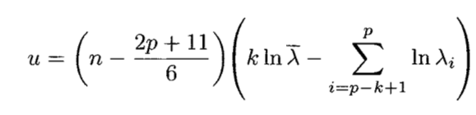
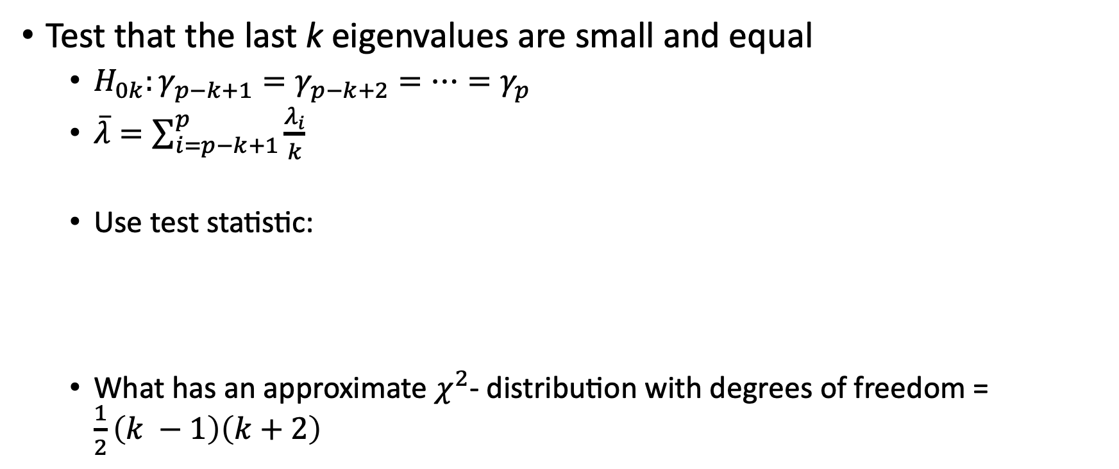
Test significance
Test that the last k eigenvalues are small and equal
$H_{0k}:γ_{p−k+1}=γ_{p−k+2}=…=γ_{p}$
$\overline{λ}=\sum_{i=p−k+1}^{p}{\frac{λ_{i}}{k}}$
Use test statistic:
What has an approximate $χ^{2}$- distribution with degrees of freedom = $\frac{1}{2}\left(k −1\right)\left(k+2\right)$

Slide 17
Interpretation of PCs
If one variable has a much larger variance than others – that variable will dominate the first component
If all variables are uncorrelated then eigenvectors will recreate original vectors (see example)

Slide 18
Selection of Variables
Associate a variable with the eigen value that has the largest absolute coefficient in the eigen vector.

Slide 19
Homework

